Slide 1
Michigan Guardianship Diversion Project There may be an alternative to adult guardianship!

Slide 2
Autonomy Matters
“People with greater self determination are healthier, more independent, and better able to recognize and resist abuse.”
See, e,g., Khemka, Hickson, & Reynolds, 2005; O’Connor & Vallerand, 1994; Wehmeyer & Schwartz, 1998

Slide 3
What is MEJI?
a non-profit civil legal aid organization, part of larger legal aid network
advocates for and represents low-income older adults and people with disabilities on issues related to healthcare, benefits, long term care, elder abuse, and individual rights.
has long sought to limit the appointment of guardians when less restrictive alternatives are available and to improve the state guardianship system.

Slide 4
What is the Michigan Guardianship Diversion Project (MGDP)?
pilot project in 4 counties: Bay, Genesee, Muskegon, and Grand Traverse for 2 years (2024-2025)
2 full time staff: Laura Kubit & Rachel Richards
seeks to reduce unnecessary guardianships and empower older adults and individuals with disabilities by connecting them to community services, public benefits, and legal alternatives to guardianship.

Slide 5
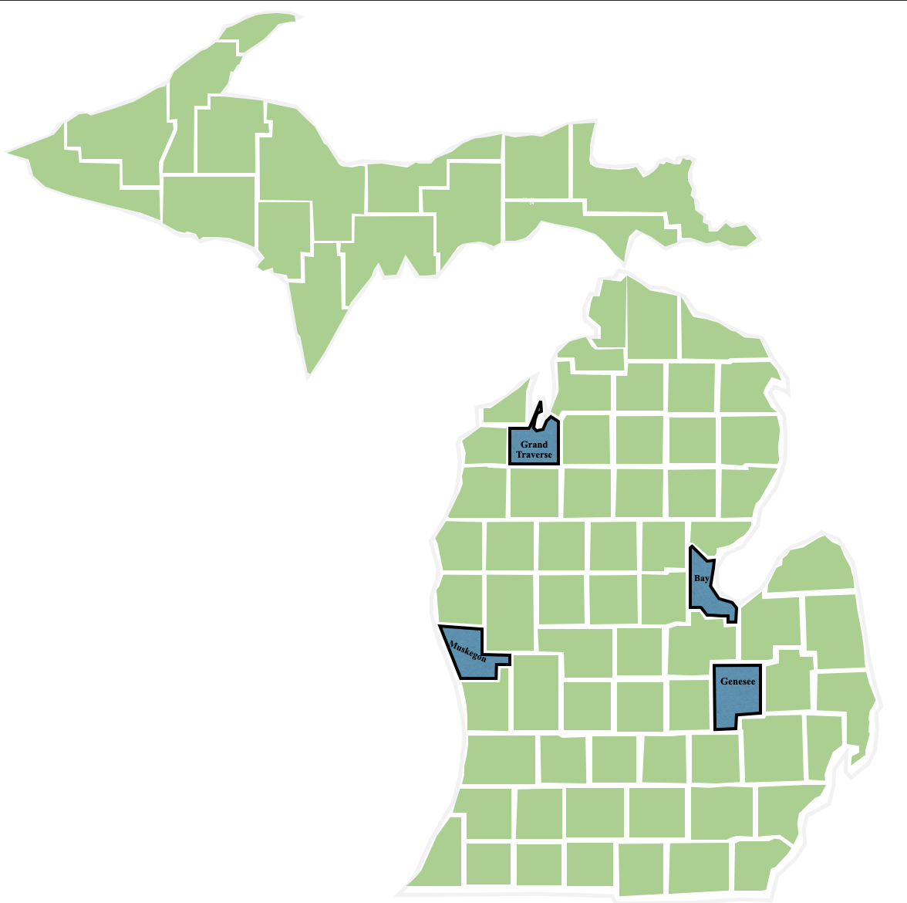
MGDP 4 Pilot Counties:
Bay
Genesee
Grand Traverse
Muskegon

Slide 6
Why Guardianship Diversion?
While guardianship is an important tool to protect vulnerable adults where there is no other option, it can be used too often, too broadly, and without recognizing the individual’s abilities, needs, and preferences. Utilizing less restrictive alternatives can often meet people’s needs while preserving their cherished right to make decisions for themselves.

Slide 7
Dignity of Risk
Making choices that others think are unwise does not mean you are incapacitated

Slide 8
What is the problem petitioners are trying to solve?

Slide 9
Common Problems that lead people to consider Guardianship
Safety and cleanliness concerns at home
Nursing home, hospital, or other agency advising that guardianship is needed
Problem with paying bills and managing money
Threatened eviction
Financial exploitation

Slide 10
Problems that Guardianship does NOT solve
Making someone take medication
Concerns about unhealthy relationships
Addiction concerns (gambling and substance use)
Family discord

Slide 11
Capacity for What?

Slide 12
Basics about Capacity
Capacity is the ability to make and communicate well-reasoned decisions
Can vary throughout the day and from week to week
Has no on/off switch
It is on a spectrum
May have capacity in one area but not another
Confusion may be temporary based on a variety of factors including medication interactions, UTI, electrolyte imbalances, etc.

Slide 13
Capacity for What?
Money
Medical Decisions?
Property?
Visitors?
Intimate Relationships?
Contracts?
Smoking?
Food?
Powers of Attorney?
Living Arrangements?

Slide 14
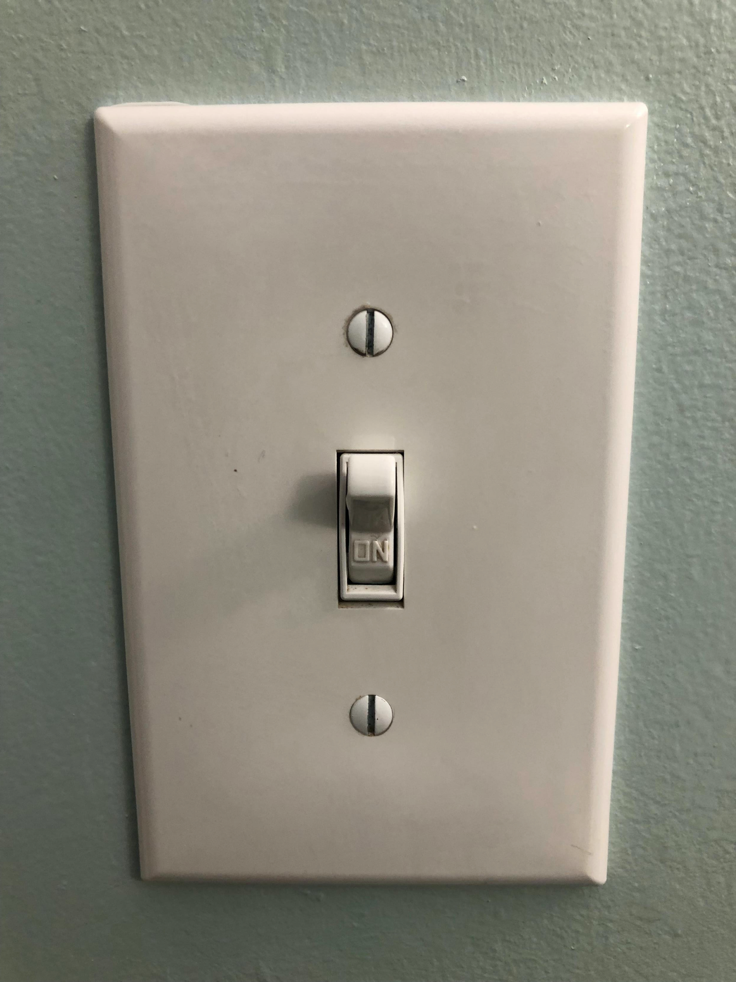
√

Slide 15
Listen to the vulnerable adult
Pay attention to what they are communicating and help them meet their needs.
What are their goals and concerns?
Who can help?

Slide 16
THANK YOU
Laura Kubit
lkubit@meji.org
517-827-8028
www.meji.org

